Slide 1
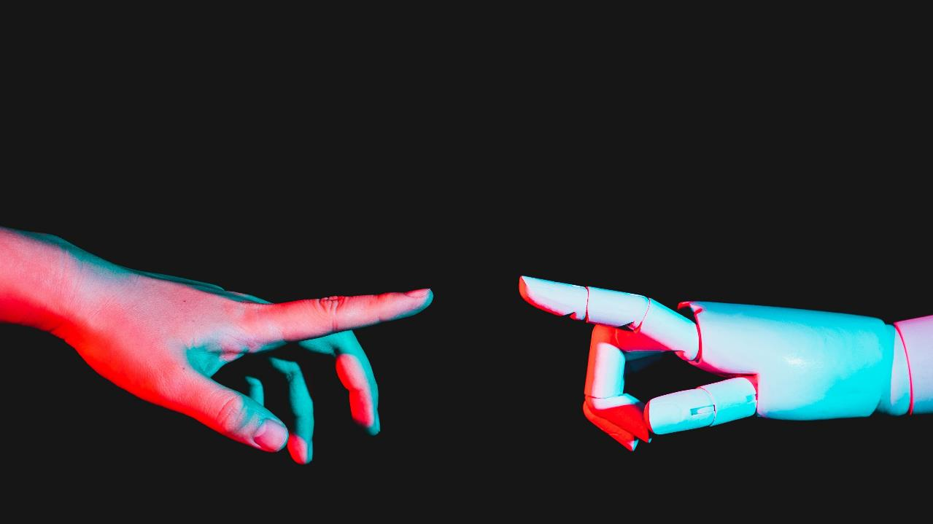
EDUHELP
JAVASCRIPT FINAL PROJECT- CIS 302

Slide 2
agenda
Project Objective
Design with Figma
Use of DOM and BOM modules
Front –End Technologies
Features of JavaScript
Project Demo

Slide 3

Project objective
The "EduHelp" project aims to create an interactive web application that provides study tips and guidance to future Year Up United students. The webpage includes a Pomodoro timer, which will help students manage their time effectively by promoting focused study sessions and regular breaks.

Slide 4
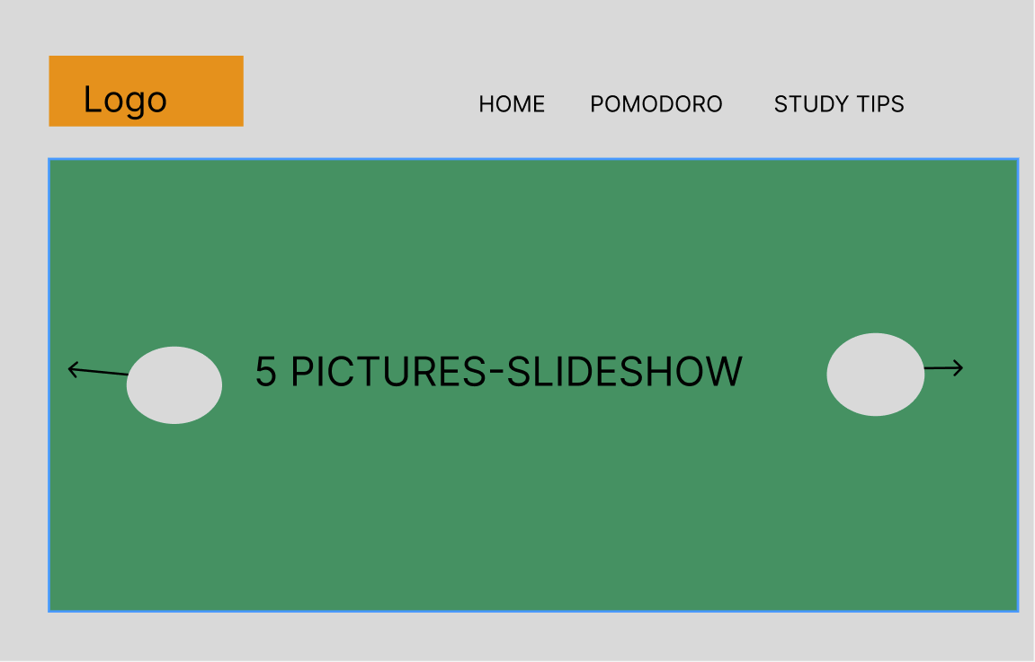
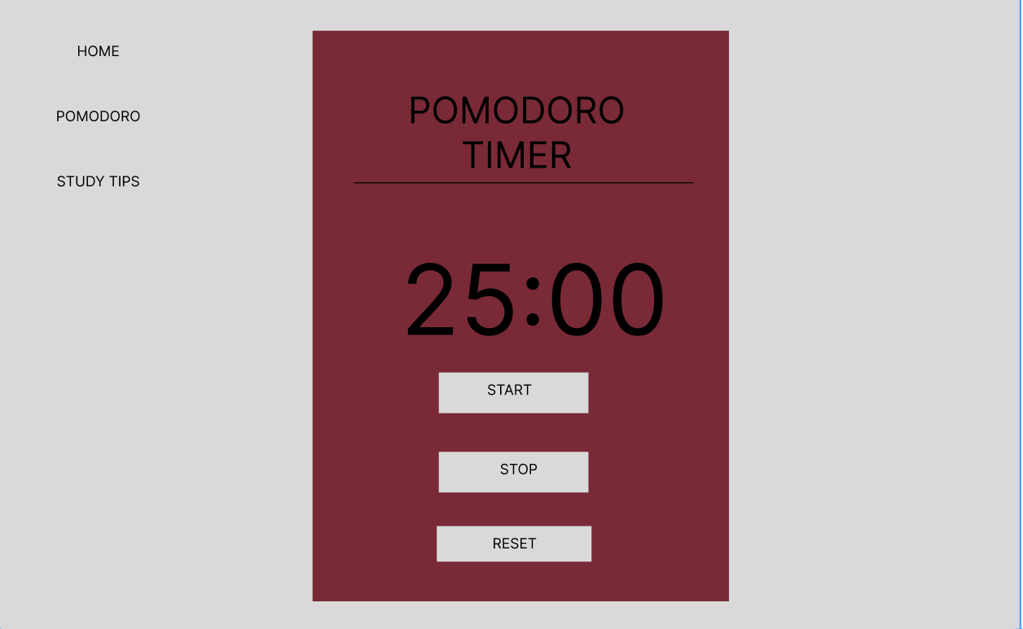
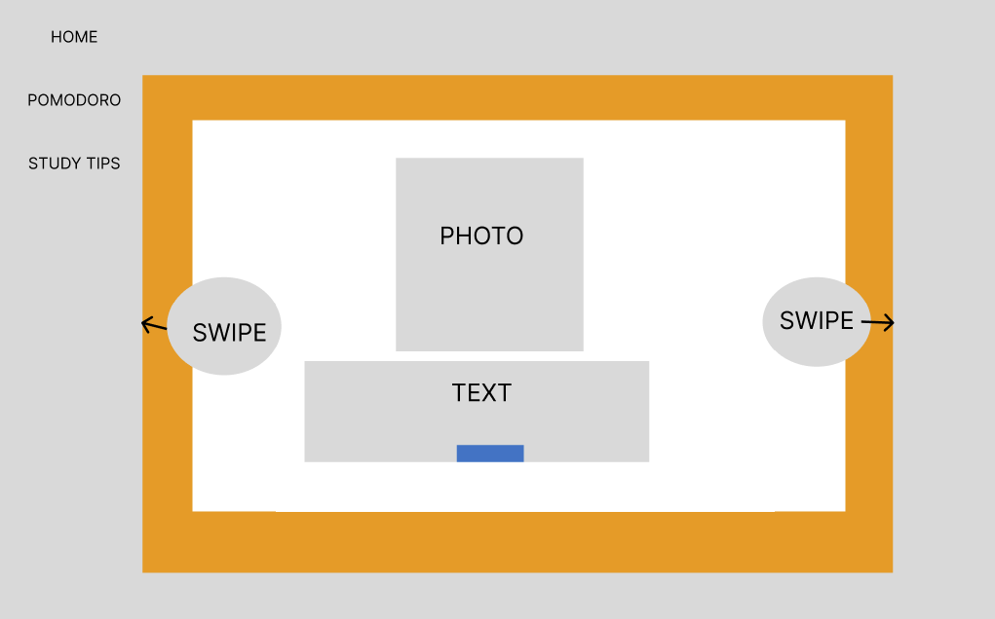
Design with figma
Slideshow
Timer
Swiping

Slide 5

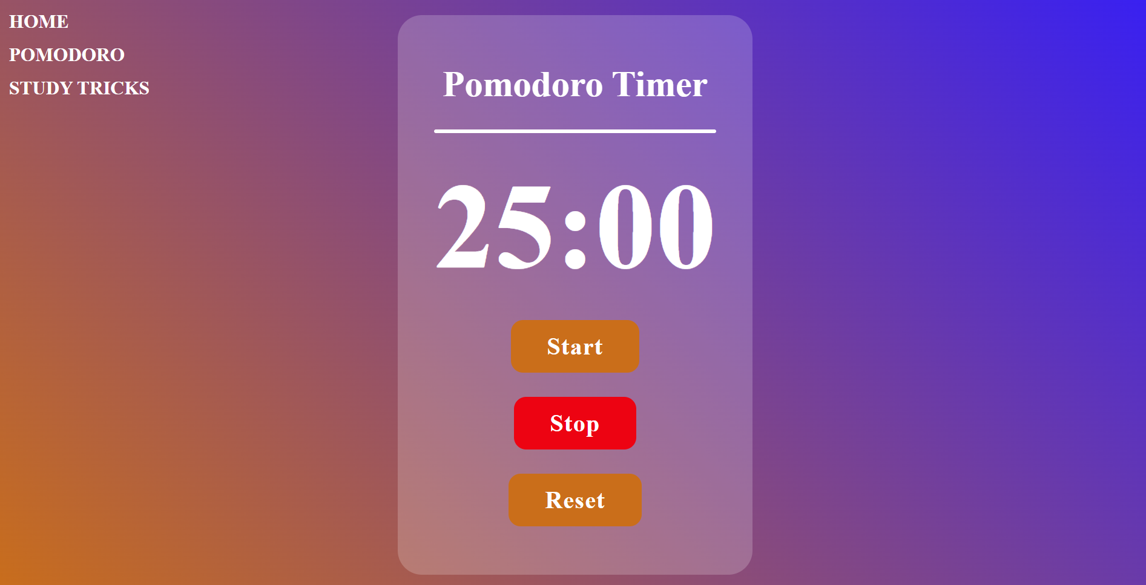
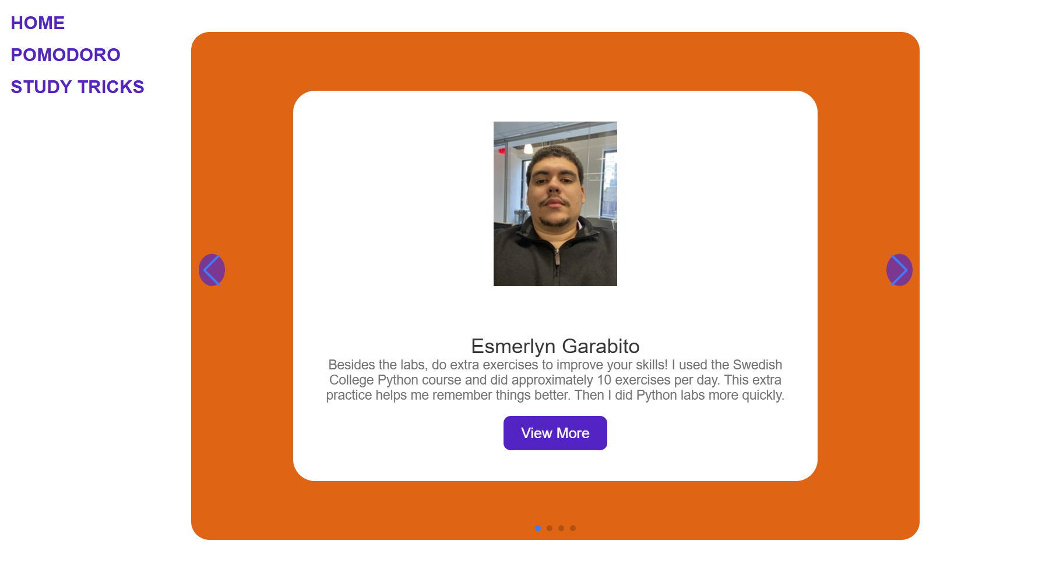
Dom and bom models
Document.getElementById() to access to slideshow elements;
setInterval() to change images
Document.get ElementByID() to access the timer display and update it.
Using Swiper.js, library for creating responsive, touch-enabled carousels and sliders.

Slide 6

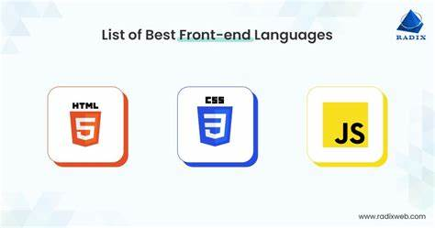
Front-end technologies used
SWIPER.JS LIBRARY

Slide 7
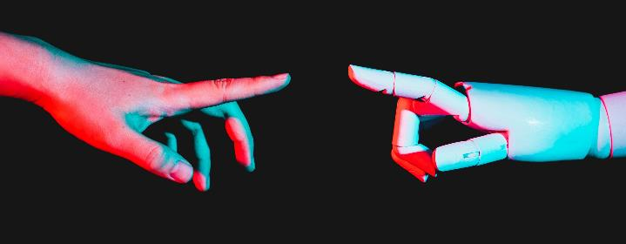
Features of javascript
Object Initialization
DOM Manipulation
Event Listeners
Intervals
Math Functions
6. Array Methods
7. Conditionals
8. Event Handling
9. Third-Party Library
10. Custom Functions

Slide 8
Thank you

